Slide 1
Computer Science
Branch and Bound Algorithm
Samuel Lukas

Slide 2
Introduction
B&B algorithms is an algorithm to solve NP-hard discrete optimization problem. It searches the complete space of solutions for a given problem for the best solution.
At any point during the solution process, the status of the solution with respect to the search of the solution space is described by a pool of yet unexplored subset of this and the best solution found so far. Initially only one subset exists, namely the complete solution space, and the best solution found so far is A. The unexplored subspaces are represented as nodes in a dynamically generated search tree, which initially only contains the root, and each iteration of a classical B&B algorithm processes one such node. The iteration has three main components :
Selection of the node to process
Bound calculation
Branching if needed

Slide 3
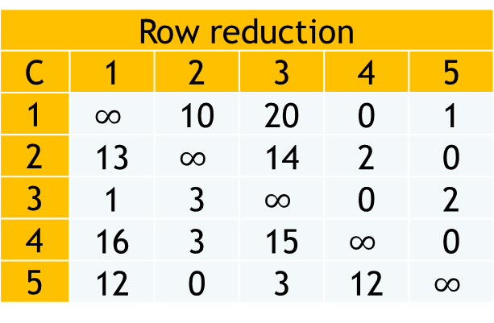
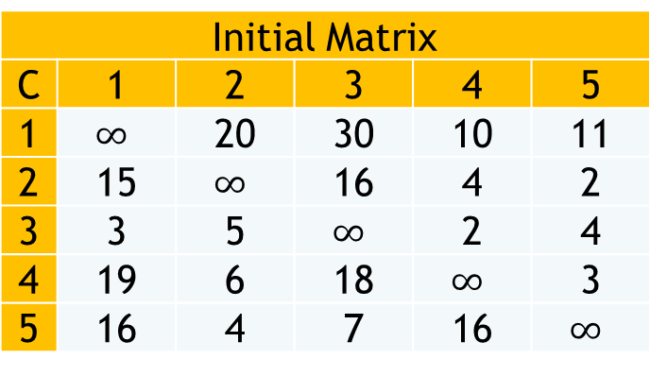

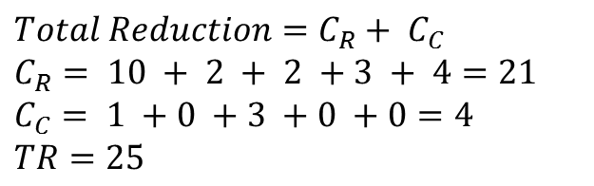
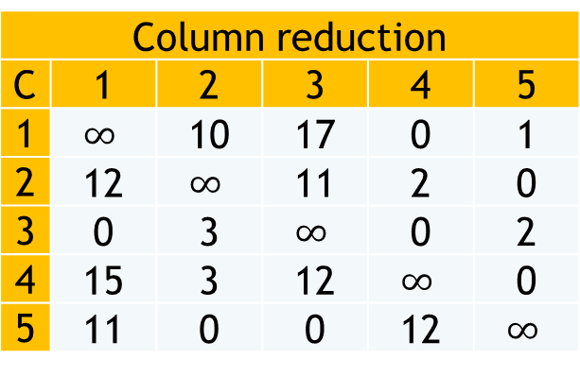
Traveling salesmen Problem Example
Initial Matrix
C | 1 | 2 | 3 | 4 | 5
1 | $$∞$$ | 20 | 30 | 10 | 11
2 | 15 | $$∞$$ | 16 | 4 | 2
3 | 3 | 5 | $$∞$$ | 2 | 4
4 | 19 | 6 | 18 | $$∞$$ | 3
5 | 16 | 4 | 7 | 16 | $$∞$$
Row reduction
C | 1 | 2 | 3 | 4 | 5
1 | $$∞$$ | 10 | 20 | 0 | 1
2 | 13 | $$∞$$ | 14 | 2 | 0
3 | 1 | 3 | $$∞$$ | 0 | 2
4 | 16 | 3 | 15 | $$∞$$ | 0
5 | 12 | 0 | 3 | 12 | $$∞$$
$$Total Reduction=C_{R}+ C_{C}$$
$$C_{R}= 10 + 2 + 2 +3 + 4=21$$
$$C_{C}= 1 +0 +3 +0 +0=4$$
$TR=25$
Column reduction
C | 1 | 2 | 3 | 4 | 5
1 | $$∞$$ | 10 | 17 | 0 | 1
2 | 12 | $$∞$$ | 11 | 2 | 0
3 | 0 | 3 | $$∞$$ | 0 | 2
4 | 15 | 3 | 12 | $$∞$$ | 0
5 | 11 | 0 | 0 | 12 | $$∞$$
$$LB(R)=25$$
1
2
3
4
5

Slide 4


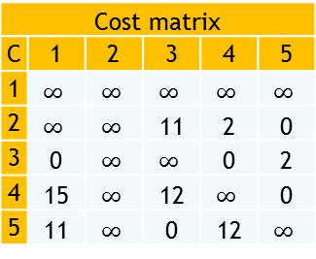
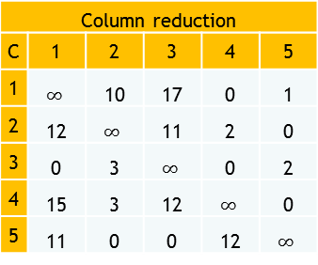
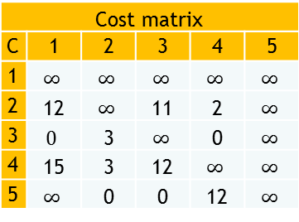



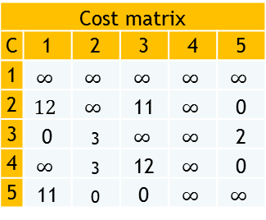



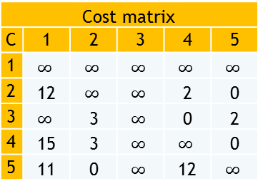


Column reduction
C | 1 | 2 | 3 | 4 | 5
1 | $$∞$$ | 10 | 17 | 0 | 1
2 | 12 | $$∞$$ | 11 | 2 | 0
3 | 0 | 3 | $$∞$$ | 0 | 2
4 | 15 | 3 | 12 | $$∞$$ | 0
5 | 11 | 0 | 0 | 12 | $$∞$$
$$LB(1)=25$$
$$LB\left(x,y\right)=LB\left(x\right)+A\left(x,y\right)+TR$$
1
5
5
3
4
5
3
4
2
3
2
2
$$LB(1,2)=35$$
$$LB(1,2)=53$$
$$LB(1,4)=25$$
$$LB(1,4)=31$$
Cost matrix
C | 1 | 2 | 3 | 4 | 5
1 | $$∞$$ | $$∞$$ | $$∞$$ | $$∞$$ | $$∞$$
2 | $$∞$$ | $$∞$$ | 11 | 2 | 0
3 | 0 | $$∞$$ | $$∞$$ | 0 | 2
4 | 15 | $$∞$$ | 12 | $$∞$$ | 0
5 | 11 | $$∞$$ | 0 | 12 | $$∞$$
Cost matrix
C | 1 | 2 | 3 | 4 | 5
1 | $$∞$$ | $$∞$$ | $$∞$$ | $$∞$$ | $$∞$$
2 | 12 | $$∞$$ | $$∞$$ | 2 | 0
3 | $$∞$$ | 3 | $$∞$$ | 0 | 2
4 | 15 | 3 | $$∞$$ | $$∞$$ | 0
5 | 11 | 0 | $$∞$$ | 12 | $$∞$$
Cost matrix
C | 1 | 2 | 3 | 4 | 5
1 | $$∞$$ | $$∞$$ | $$∞$$ | $$∞$$ | $$∞$$
2 | $$12$$ | $$∞$$ | 11 | $$∞$$ | 0
3 | 0 | 3 | $$∞$$ | $$∞$$ | 2
4 | $$∞$$ | 3 | 12 | $$∞$$ | 0
5 | 11 | 0 | 0 | $$∞$$ | $$∞$$
Cost matrix
C | 1 | 2 | 3 | 4 | 5
1 | $$∞$$ | $$∞$$ | $$∞$$ | $$∞$$ | $$∞$$
2 | 12 | $$∞$$ | 11 | 2 | $$∞$$
3 | $$0$$ | 3 | $$∞$$ | 0 | $$∞$$
4 | 15 | 3 | 12 | $$∞$$ | $$∞$$
5 | $$∞$$ | 0 | 0 | 12 | $$∞$$
$$LB\left(1,2\right)=25+10+0$$
$$LB\left(1,3\right)=25+17+11$$
$$LB\left(1,4\right)=25+0+0$$
$$LB\left(1,4\right)=25+1+5$$

Slide 5
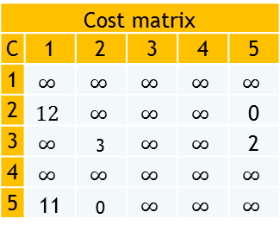





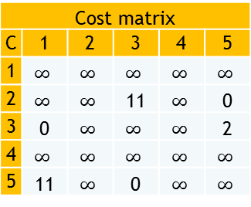



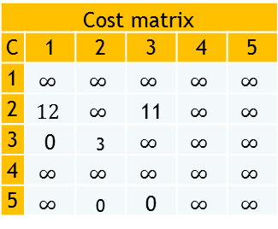
Column reduction
C | 1 | 2 | 3 | 4 | 5
1 | $$∞$$ | 10 | 17 | 0 | 1
2 | 12 | $$∞$$ | 11 | 2 | 0
3 | 0 | 3 | $$∞$$ | 0 | 2
4 | 15 | 3 | 12 | $$∞$$ | 0
5 | 11 | 0 | 0 | 12 | $$∞$$
$$LB(R)=25$$
$$LB\left(x,y\right)=LB\left(x\right)+A\left(x,y\right)+TR$$
1
2
3
4
5
$$LB(1,2)=35$$
$$LB(1,2)=53$$
$$LB(1,4)=25$$
$$LB(1,4)=31$$
Cost matrix
C | 1 | 2 | 3 | 4 | 5
1 | $$∞$$ | $$∞$$ | $$∞$$ | $$∞$$ | $$∞$$
2 | $$∞$$ | $$∞$$ | 11 | $$∞$$ | 0
3 | 0 | $$∞$$ | $$∞$$ | $$∞$$ | 2
4 | $$∞$$ | $$∞$$ | $$∞$$ | $$∞$$ | $$∞$$
5 | 11 | $$∞$$ | 0 | $$∞$$ | $$∞$$
$$LB(1,4,2)=28$$
$$LB(1,4,3)=50$$
$$LB(1,4,5)=36$$
2
3
2
3
3
5
5
5
Cost matrix
C | 1 | 2 | 3 | 4 | 5
1 | $$∞$$ | $$∞$$ | $$∞$$ | $$∞$$ | $$∞$$
2 | $$12$$ | $$∞$$ | $$∞$$ | $$∞$$ | 0
3 | $$∞$$ | 3 | $$∞$$ | $$∞$$ | 2
4 | $$∞$$ | $$∞$$ | $$∞$$ | $$∞$$ | $$∞$$
5 | 11 | 0 | $$∞$$ | $$∞$$ | $$∞$$
Cost matrix
C | 1 | 2 | 3 | 4 | 5
1 | $$∞$$ | $$∞$$ | $$∞$$ | $$∞$$ | $$∞$$
2 | $$12$$ | $$∞$$ | 11 | $$∞$$ | $$∞$$
3 | 0 | 3 | $$∞$$ | $$∞$$ | $$∞$$
4 | $$∞$$ | $$∞$$ | $$∞$$ | $$∞$$ | $$∞$$
5 | $$∞$$ | 0 | 0 | $$∞$$ | $$∞$$
$$LB\left(1,4,2\right)=25+3+0$$
$$LB\left(1,4,5\right)=25+0+11$$
$$LB\left(1,4,3\right)=25+12+13$$

Slide 6




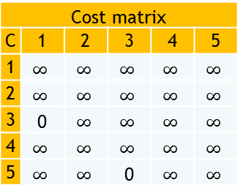


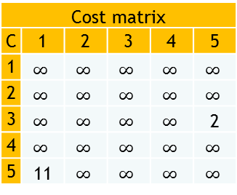



Column reduction
C | 1 | 2 | 3 | 4 | 5
1 | $$∞$$ | 10 | 17 | 0 | 1
2 | 12 | $$∞$$ | 11 | 2 | 0
3 | 0 | 3 | $$∞$$ | 0 | 2
4 | 15 | 3 | 12 | $$∞$$ | 0
5 | 11 | 0 | 0 | 12 | $$∞$$
$$LB(R)=25$$
$$LB\left(x,y\right)=LB\left(x\right)+A\left(x,y\right)+TR$$
1
2
3
4
5
$$LB(1,2)=35$$
$$LB(1,2)=53$$
$$LB(1,4)=25$$
$$LB(1,4)=31$$
Cost matrix
C | 1 | 2 | 3 | 4 | 5
1 | $$∞$$ | $$∞$$ | $$∞$$ | $$∞$$ | $$∞$$
2 | $$∞$$ | $$∞$$ | $$∞$$ | $$∞$$ | $$∞$$
3 | $$∞$$ | $$∞$$ | $$∞$$ | $$∞$$ | 2
4 | $$∞$$ | $$∞$$ | $$∞$$ | $$∞$$ | $$∞$$
5 | 11 | $$∞$$ | $$∞$$ | $$∞$$ | $$∞$$
$$LB(1,4,2)=28$$
$$LB(1,4,3)=50$$
$$LB(1,4,5)=36$$
2
3
5
3
3
3
5
5
5
Cost matrix
C | 1 | 2 | 3 | 4 | 5
1 | $$∞$$ | $$∞$$ | $$∞$$ | $$∞$$ | $$∞$$
2 | $$∞$$ | $$∞$$ | $$∞$$ | $$∞$$ | $$∞$$
3 | 0 | $$∞$$ | $$∞$$ | $$∞$$ | $$∞$$
4 | $$∞$$ | $$∞$$ | $$∞$$ | $$∞$$ | $$∞$$
5 | $$∞$$ | $$∞$$ | 0 | $$∞$$ | $$∞$$
$$LB(1,4,2,3)=52$$
3
$$LB\left(1,4,2,3\right)=28+11+13$$
3
$$LB\left(1,4,2,5\right)=28+0+0=28$$
$$LB\left(1,4,2,5,3,1\right)=28+0+0=28$$
$$LB\left(1,4,2,5,3,1\right)=28+0+0=28$$

Slide 7
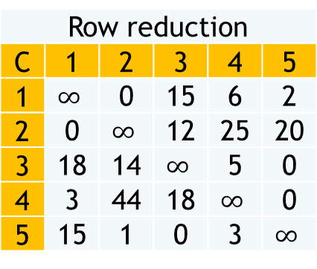
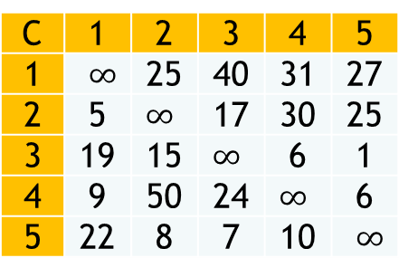
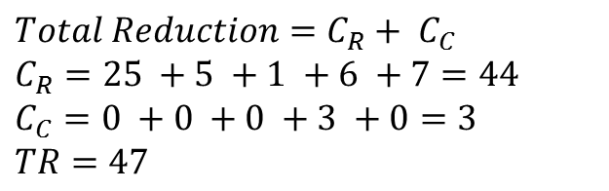
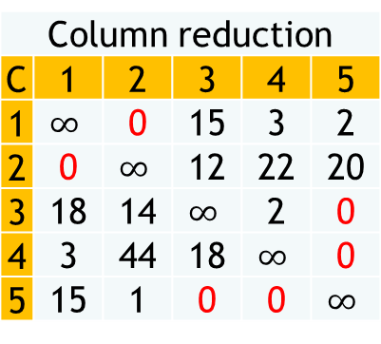
Exercise TSP
Row reduction
C | 1 | 2 | 3 | 4 | 5
1 | $$∞$$ | 0 | 15 | 6 | 2
2 | 0 | $$∞$$ | 12 | 25 | 20
3 | 18 | 14 | $$∞$$ | 5 | 0
4 | 3 | 44 | 18 | $$∞$$ | 0
5 | 15 | 1 | 0 | 3 | $$∞$$
Column reduction
C | 1 | 2 | 3 | 4 | 5
1 | $$∞$$ | 0 | 15 | 3 | 2
2 | 0 | $$∞$$ | 12 | 22 | 20
3 | 18 | 14 | $$∞$$ | 2 | 0
4 | 3 | 44 | 18 | $$∞$$ | 0
5 | 15 | 1 | 0 | 0 | $$∞$$
C | 1 | 2 | 3 | 4 | 5
1 | $∞$ | 25 | 40 | 31 | 27
2 | 5 | $∞$ | 17 | 30 | 25
3 | 19 | 15 | $∞$ | 6 | 1
4 | 9 | 50 | 24 | $∞$ | 6
5 | 22 | 8 | 7 | 10 | $∞$
$$Total Reduction=C_{R}+ C_{C}$$
$$C_{R}=25 +5 +1 +6 +7=44$$
$$C_{C}=0 +0 +0 +3 +0=3$$
$TR=47$
Best-Node
C | 1 | 2 | 3 | 4 | 5
1 | 0 | 3 | 0 | 0 | 0
2 | 15 | 0 | 0 | 0 | 0
3 | 0 | 0 | 0 | 0 | 2
4 | 0 | 0 | 0 | 0 | 3
5 | 0 | 0 | 12 | 2 | 0
Find Best Node Table by changing all non zero value from column reduction table to zero and zero value by adding the lowest two value from row and column respectively. Best node is largest value from that table.

Slide 8
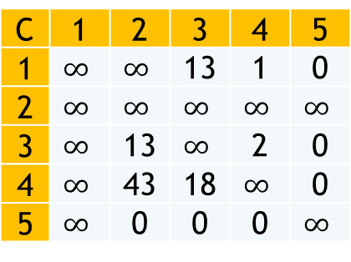






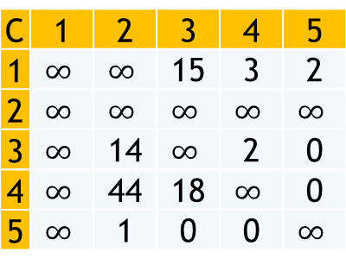

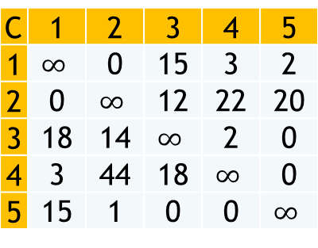


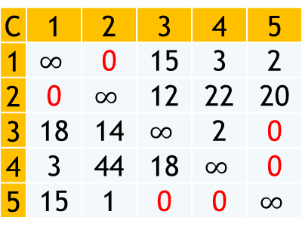


C | 1 | 2 | 3 | 4 | 5
1 | $$∞$$ | 0 | 15 | 3 | 2
2 | 0 | $$∞$$ | 12 | 22 | 20
3 | 18 | 14 | $$∞$$ | 2 | 0
4 | 3 | 44 | 18 | $$∞$$ | 0
5 | 15 | 1 | 0 | 0 | $$∞$$
C | 1 | 2 | 3 | 4 | 5
1 | $$∞$$ | 0 | 15 | 3 | 2
2 | 0 | $$∞$$ | 12 | 22 | 20
3 | 18 | 14 | $$∞$$ | 2 | 0
4 | 3 | 44 | 18 | $$∞$$ | 0
5 | 15 | 1 | 0 | 0 | $$∞$$
C | 1 | 2 | 3 | 4 | 5
1 | $$∞$$ | 0 | 15 | 3 | 2
2 | 0 | $$∞$$ | 12 | 22 | 20
3 | 18 | 14 | $$∞$$ | 2 | 0
4 | 3 | 44 | 18 | $$∞$$ | 0
5 | 15 | 1 | 0 | 0 | $$∞$$
X
$$LB\left(X\right)=47$$
$$\overline{2,1}$$
$$2,1$$
$$LB\left(Y\right)=LB\left(X\right)+Max(BestNode)$$
$$LB\left(Y\right)=47+15$$
Y
Z
Z
$$LB\left(Z\right)=50$$
C | 1 | 2 | 3 | 4 | 5
1 | $$∞$$ | $$∞$$ | 15 | 3 | 2
2 | $$∞$$ | $$∞$$ | $$∞$$ | $$∞$$ | $$∞$$
3 | $$∞$$ | 14 | $$∞$$ | 2 | 0
4 | $$∞$$ | 44 | 18 | $$∞$$ | 0
5 | $$∞$$ | 1 | 0 | 0 | $$∞$$
C | 1 | 2 | 3 | 4 | 5
1 | $$∞$$ | $$∞$$ | 13 | 1 | 0
2 | $$∞$$ | $$∞$$ | $$∞$$ | $$∞$$ | $$∞$$
3 | $$∞$$ | 14 | $$∞$$ | 2 | 0
4 | $$∞$$ | 44 | 18 | $$∞$$ | 0
5 | $$∞$$ | 1 | 0 | 0 | $$∞$$
C | 1 | 2 | 3 | 4 | 5
1 | $$∞$$ | $$∞$$ | 13 | 1 | 0
2 | $$∞$$ | $$∞$$ | $$∞$$ | $$∞$$ | $$∞$$
3 | $$∞$$ | 13 | $$∞$$ | 2 | 0
4 | $$∞$$ | 43 | 18 | $$∞$$ | 0
5 | $$∞$$ | 0 | 0 | 0 | $$∞$$
$$C_{R}=2+0+0+0+0$$
$$C_{C}=0+1+0+0+0$$
$$TR=C_{R}+C_{C}=3$$
$$LB(Z)=47+3=50$$

Slide 9
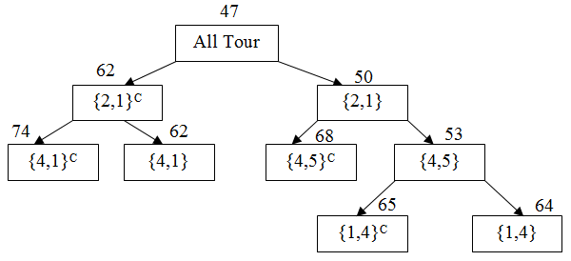
Final route is 1 2 3 5 4 1 with total = 62

Slide 10
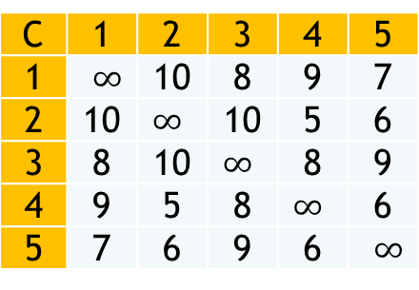
Other Example
C | 1 | 2 | 3 | 4 | 5
1 | $∞$ | 10 | 8 | 9 | 7
2 | 10 | $∞$ | 10 | 5 | 6
3 | 8 | 10 | $∞$ | 8 | 9
4 | 9 | 5 | 8 | $∞$ | 6
5 | 7 | 6 | 9 | 6 | $∞$

